Slide 1
FnP Sales Performance & Operations
Prepared by Tanvi Dedhia
Excel-based Sales, Delivery & Customer Analytics

Slide 2
Business KPIs

Slide 3
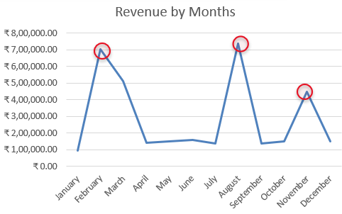
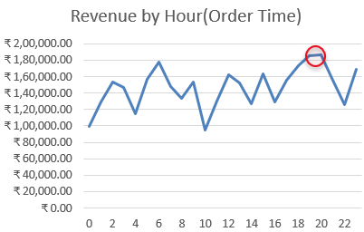
Revenue & Seasonality
Peak months: Feb, Aug, Nov
Evening order peaks

Slide 4
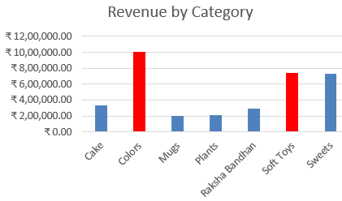
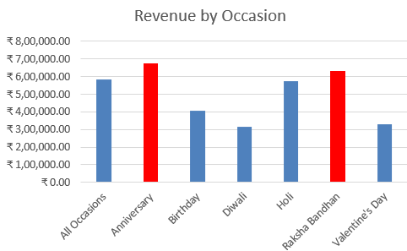
Product & Occasion Performance
Top categories: Colors, Soft Toys
Top occasions: Anniversary, Raksha Bandhan

Slide 5
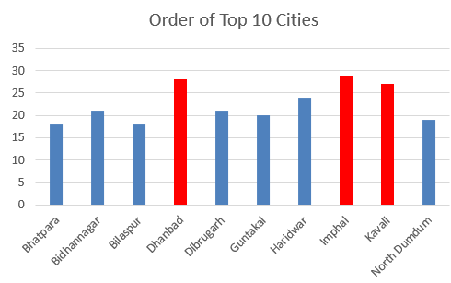
City-wise Insights
High volume cities: Imphal, Dhanbad, Kavali

Slide 6
Business Recommendations
Increase inventory for top categories
Run time-based promotions
Optimize logistics in high-volume cities

